Slide 1

Programming Fundamentals & Higher Order Programming

Slide 2
Programming Paradigms
Imperative
Procedural
Functional
Object-oriented
Logic
Styles of coding
Notes:
Programming Paradigms are Styles of coding. Using different paradigms forces you to think differently, to approach problems differently. It’s as if they’re different tools, and you must choose one to solve a problem. There are many programming paradigms. I’ll be talking about these 5.

Slide 3
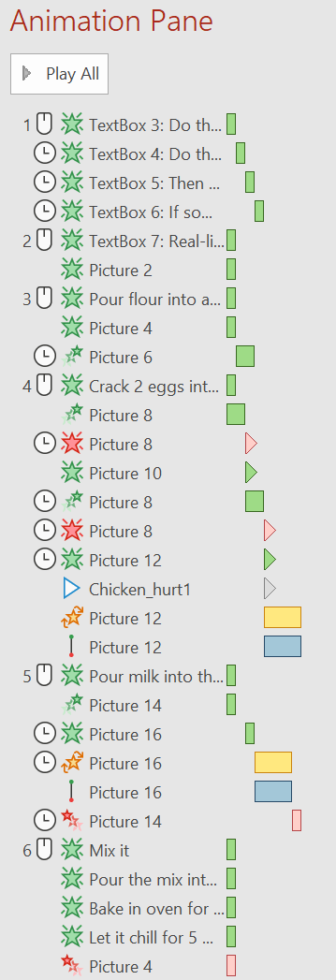










Imperative Programming
Do this
If something, then do this
Do this
Then do this
Real-life Example: Baking a cake
Pour flour into a bowl
Crack 2 eggs into the bowl
Pour milk into the bowl
Mix it
Pour the mix into a mold
Bake in oven for 30 minutes
Let it chill for 5 minutes
Notes:
You are a programmer. You want your computer to do stuff. With imperative programming, you make the computer do stuff by explicitly telling it each and every instruction. To make a cake in reak-life, you may create a step-by-step list with the following:

Slide 4
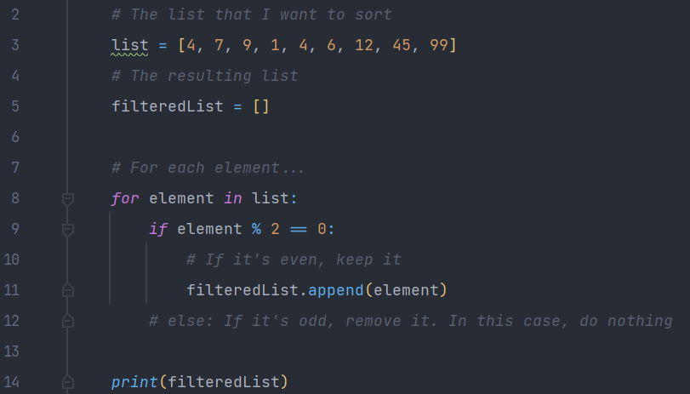
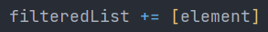
Imperative Programming
Code example: Filtering out the odd numbers in a list (in Python, since its syntax is great for reading and writing)
If the first element is an even number, keep it
If the first element is an odd number, remove it
If the second element is an even number, keep it
…
or
For each element, if it’s even, keep it
For each element, if it’s odd, remove it

Slide 5
procedural Programming
Extends Imperative Programming
Real-life Example: Baking a cake (Imperative)
Pour flour into a bowl
Crack 2 eggs into the bowl
Pour milk into the bowl
Mix it
Pour the mix into a mold
Bake in oven for 30 minutes
Let it chill for 5 minutes
Procedure: Pour ingredients
Procedure: Mix and transfer to mold
Procedure: Bake and let chill
Real-life Example: Baking a cake (Procedural)
Real-life Example: Baking many muffins (Procedural)
Pour ingredients
Mix and transfer to mold
Bake and let chill
Pour ingredients x3
Mix and transfer to mold
Add fruits
Bake and let chill
To write the algorithm, we don’t need to know how ‘Pour ingredients’ works. We only need to know what it does. This is called “Procedural Abstraction”
Notes:
Procedural programming is an extension of imperative programming. In procedural programming, we split step-by-step instructions into procedures. This lets us be more organized when specifying an algorithm (or a recipe), and it lets us re-use procedures.

Slide 6
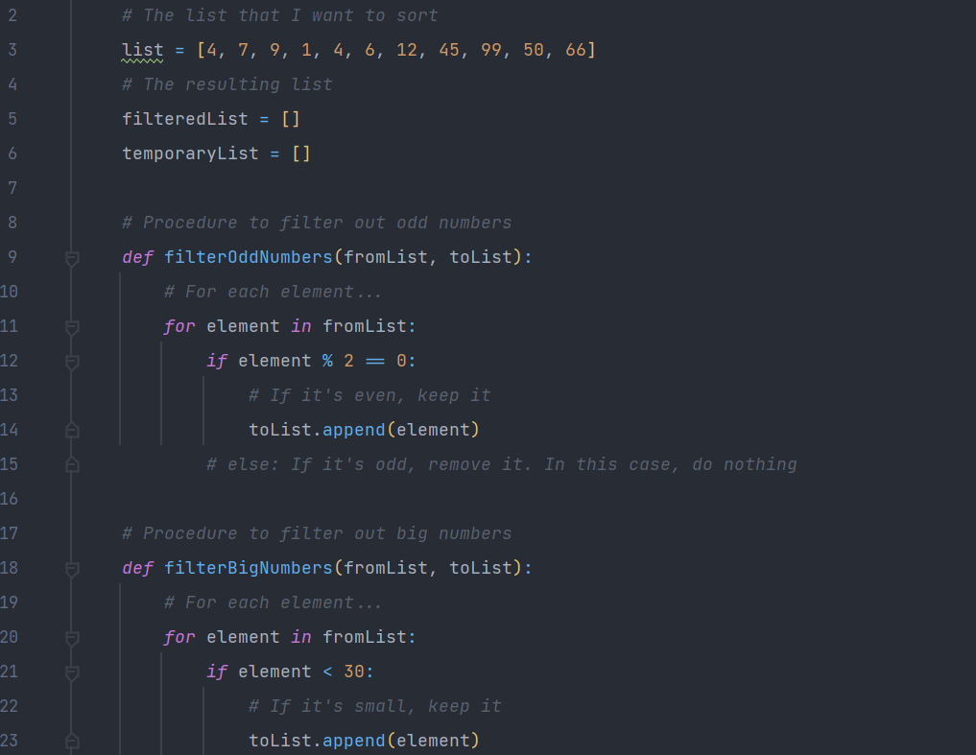
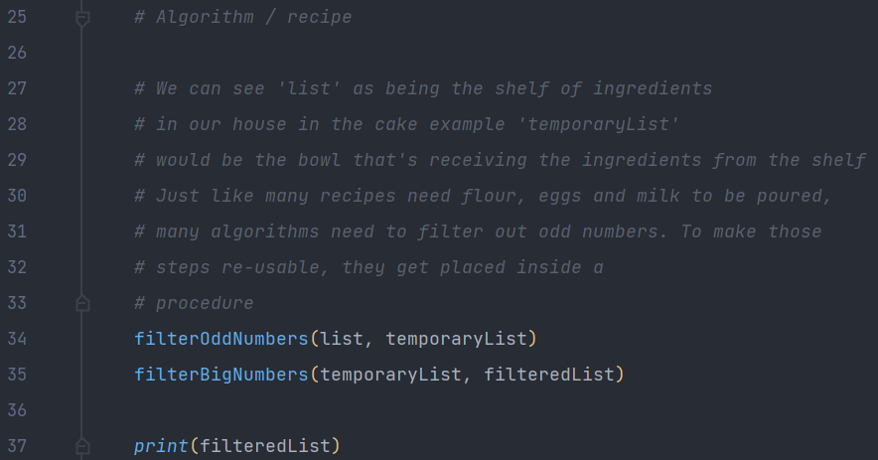
procedural Programming
Code example: Filtering out the odd and big numbers in a list (in Python)
procedure
procedure
procedure
If I wasn’t the one writing the procedure definitions, I would still be able to write the algorithm thanks to Procedural Abstraction.
procedure

Slide 7
functional Programming
First-class citizens:
Imperative instruction
If, else
For, while
First-class citizens:
Functions
How?
Second-class:
- Functions
Second-class:
- If, else
Higher Order Programming
Notes:
Functional Programming is a paradigm you’ve seen and probably used before, but not to it’s full potential. In a language whose only paradigm is functional, there are no variable declarations. There are no fors and whiles. Higher Order Programming is a consequence of Functional Programming

Slide 8
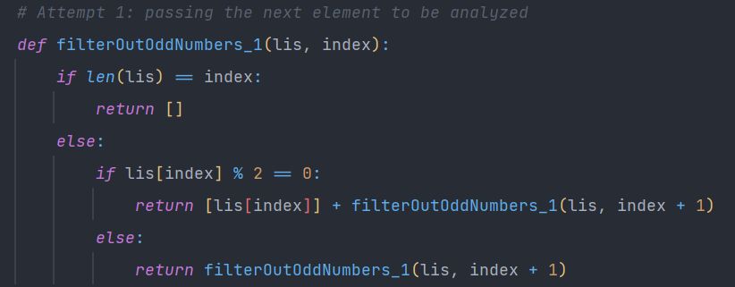
functional Programming
Code example: Filtering out the odd and big numbers in a list (in Python)
lis = [2,3,4,6,7], index = 0
len(lis) = 5, lis[0] = 2
1st iteration: return [2] + filter([2,3,4,6,7], 1)
lis = [2,3,4,6,7], index = 1
len(lis) = 5, lis[1] = 3
2nd iteration: return [2] + filter([2,3,4,6,7], 2)
lis = [2,3,4,6,7], index = 2
len(lis) = 5, lis[2] = 4
3rd iteration: return [2] + [4] + filter([2,3,4,6,7], 3)
lis = [2,3,4,6,7], index = 3
len(lis) = 5, lis[3] = 6
4th iteration: return [2] + [4] + [6] + filter([2,3,4,6,7], 4)
lis = [2,3,4,6,7], index = 4
len(lis) = 5, lis[4] = 7
5th iteration: return [2] + [4] + [6] + filter([2,3,4,6,7], 5)
lis = [2,3,4,6,7], index = 5
len(lis) = 5, lis[5] = out of bounds
6th iteration: return [2] + [4] + [6] + []
[2, 4, 6]

Slide 9
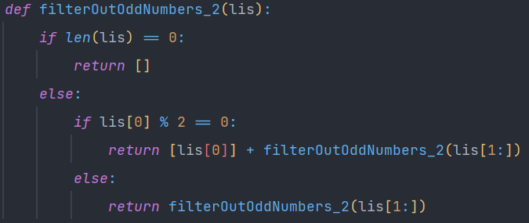
functional Programming
Code example: Filtering out the odd and big numbers in a list (in Python)
lis = [2,3,4,6,7]
len(lis) = 5 lis[0] = 2
1st iteration: return [2] + filter([3,4,6,7])
lis = [3,4,6,7]
len(lis) = 4 lis[0] = 3
0 1 2 3 4
2nd iteration: return [2] + filter([4,6,7])
[2,3,4,6,7]
lis = [4,6,7]
len(lis) = 3 lis[0] = 3
3rd iteration: return [2] + [4] + filter([6,7])
lis = [6,7]
len(lis) = 2 lis[0] = 6
4th iteration: return [2] + [4] + [6] + filter([7])
lis = [7]
len(lis) = 1 lis[0] = 7
5th iteration: return [2] + [4] + [6] + filter([])
lis = []
len(lis) = 0 lis[0] = out of bounds
6th iteration: return [2] + [4] + [6] + []
[2, 4, 6]

Slide 10

exercises
Topic9_Python/Exercises/FunctionalProgramming
Exercise 1 and 2. If you quickly solved them, solve Exercise 3 (warning: it’s hard!)

Slide 11
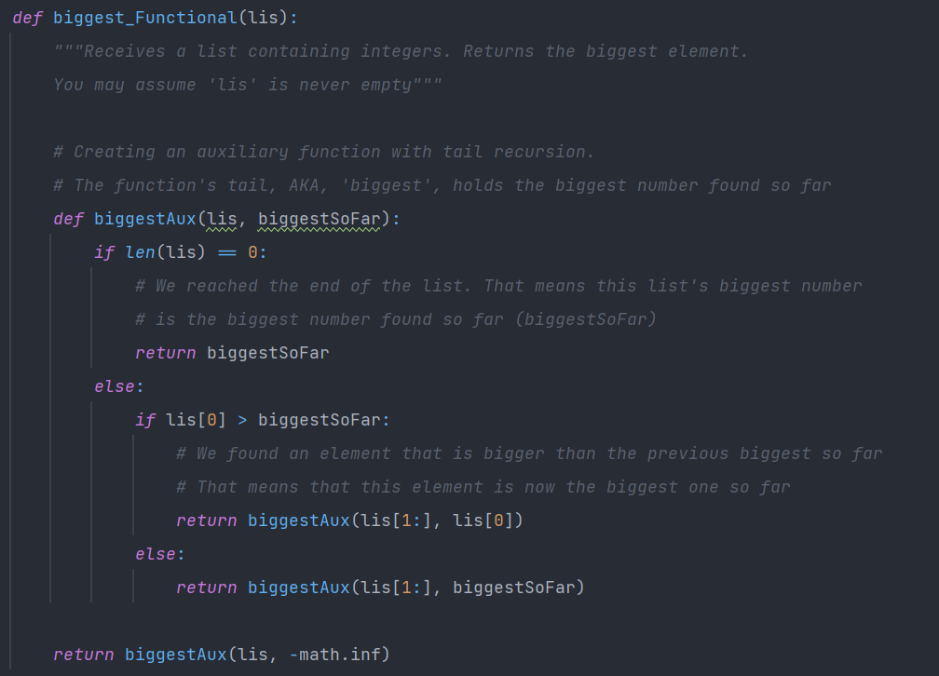
functional Programming
Tail recursion
Code example (exercise 3): Getting the biggest number in a list (in Python)
lis = [4,6,5,100,75]
1st recursive call: return biggestAux([4,6,5,100,75], -∞)
lis = [4,6,5,100,75]
biggestSoFar = -∞ lis[0] = 4
1st inner recursive call: return biggestAux([6,5,100,75], 4)
lis = [6,5,100,75]
biggestSoFar = 4 lis[0] = 6
2nd inner recursive call: return biggestAux([5,100,75], 6)
lis = [5,100,75]
biggestSoFar = 6 lis[0] = 5
3rd inner recursive call: return biggestAux([100,75], 6)
lis = [100,75]
biggestSoFar = 6 lis[0] = 100
4th inner recursive call: return biggestAux([75], 100)
lis = [75]
biggestSoFar = 100 lis[0] = 75
5th inner recursive call: return biggestAux([], 100)
lis = []
biggestSoFar = 100 lis[0] = out of bounds
6th inner recursive call: return 100
Notes:
To solve exercise 3, we need to employ a Functional Programming strategy called “Tail Recursion”. Tail Recursion is used when we need the recursive calls to memorize some useful information. Recursion can be used to iterate over a list. But if we want to figure out what the biggest number is, we need to keep track of the biggest number found so far, much like we do in Imperative Programming. Nothing’s preventing us from creating an auxiliary function that has an extra argument: the biggest number found so far. This extra argument is called the “tail”

Slide 12
functional Programming
vs
imperative Programming
So far, Imperative seems easier.
Functional requires us to think from the end (we start with the bottom case, ex: empty list).
However, some problems are extremely difficult to solve using Imperative only.
These Paradigms are 2 distinct tools. Some are better suited for some problems that the other is not.

Slide 13
functional Programming
Is good for: divide and conquer algorithms
Code example: Merge sort algorithm: https://www.programiz.com/dsa/merge-sort
The Merge Sort algorithm combines Imperative and Functional
We’ll see how it works in detail on the Algorithms Topic. In short:
Base idea: Combining 2 sorted lists into a single sorted list is very easy:
1
2
5
8
9
10
11
14
5
8
9
11
1
2
10
14
List 1
List 2
Combined lists

Slide 14
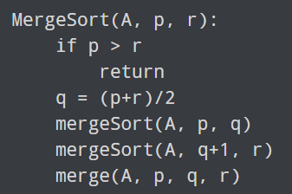
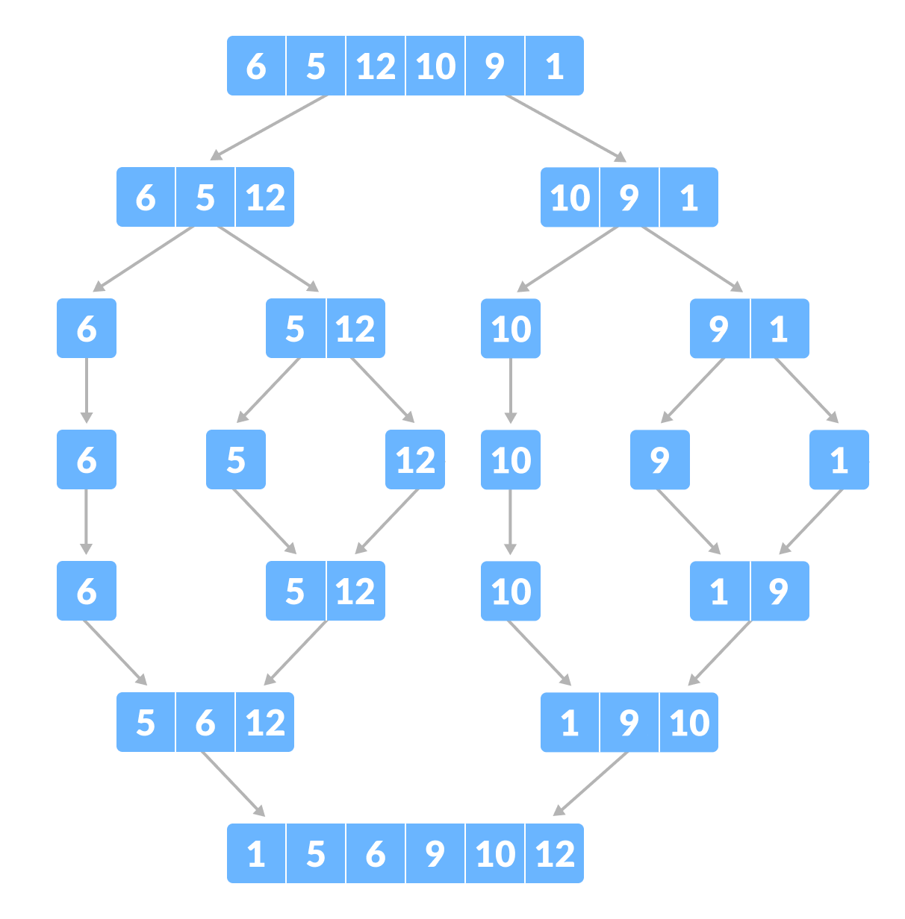
functional Programming
Is good for: divide and conquer algorithms
Code example: Merge sort algorithm: https://www.programiz.com/dsa/merge-sort
The Merge Sort algorithm combines Imperative and Functional
We’ll see how it works in detail on the Algorithms Topic. In short:
A = [6,5,12,10,9,1] p = 0 r = 5
==
1st call: mergeSort([6,5,12,10,9,1], 0, 5)
2nd call: mergeSort([6,5,12], 0, 2)
2nd call: mergeSort([10,9,1], 3, 5)
2nd call: mergeSort([10,9], 3, 4)
2nd call: mergeSort([1], 5, 5)
Slight inconsistence: should be [6,5] [12] instead of [6] [5,12]
Etc

Slide 15
functional Programming
Code example: Quick sort algorithm: https://www.geeksforgeeks.org/quick-sort/
10-minute break! Take some rest or solve exercises 4 and 5

Slide 16
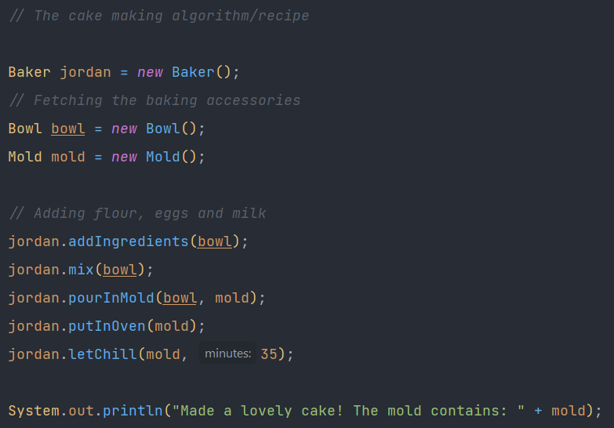
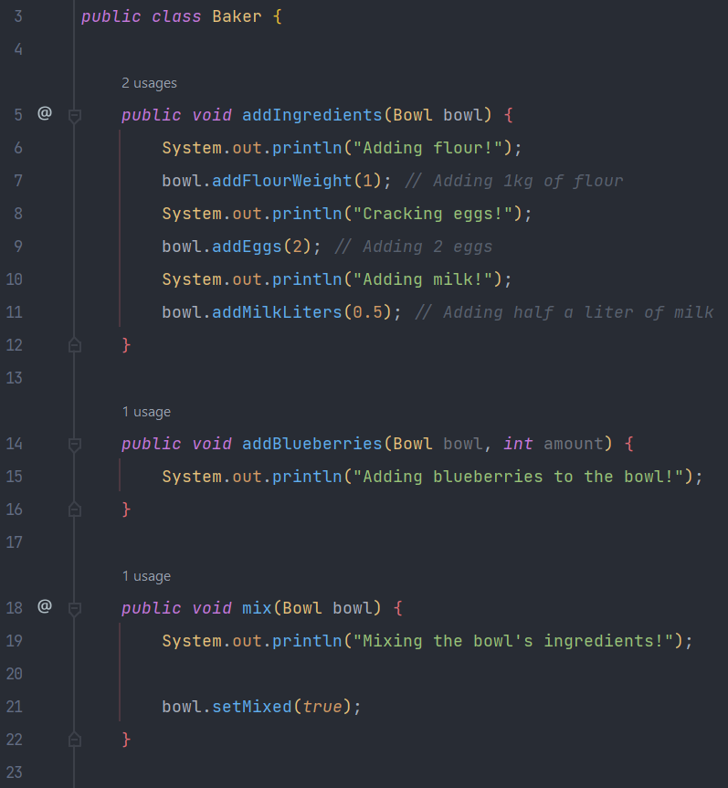
Object-oriented Programming (OOP)
Purpose: To separate concerns into entities (coded as objects)
Code example: Real life cake into code (in Java)
Main class:
Baker class:
It’s the baker’s responsibility to add ingredients, mix the bowl, pour the mixture to a mold, etc
Procedural
Programming

Slide 17
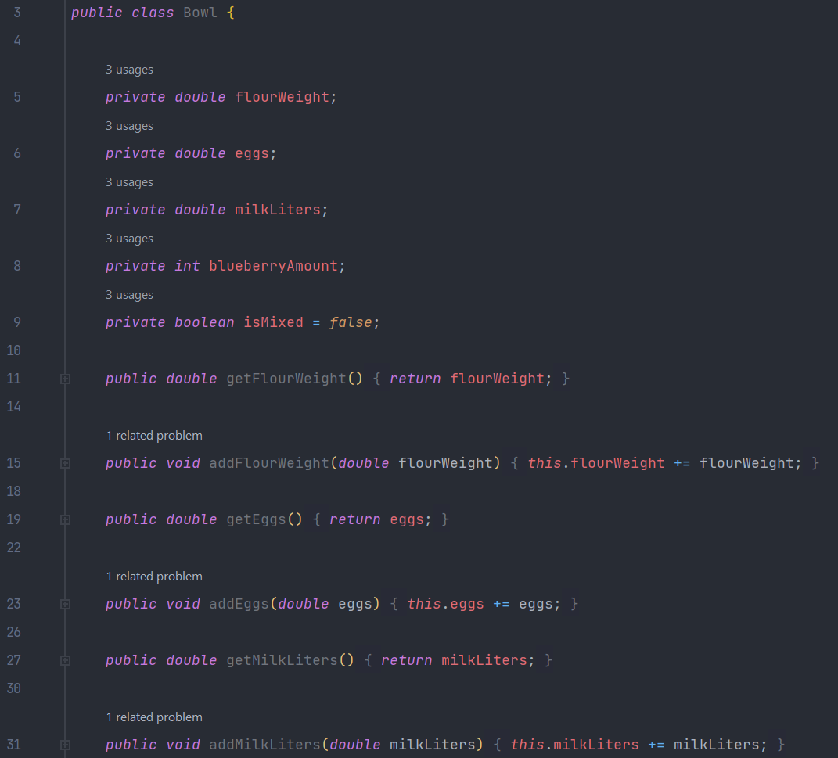
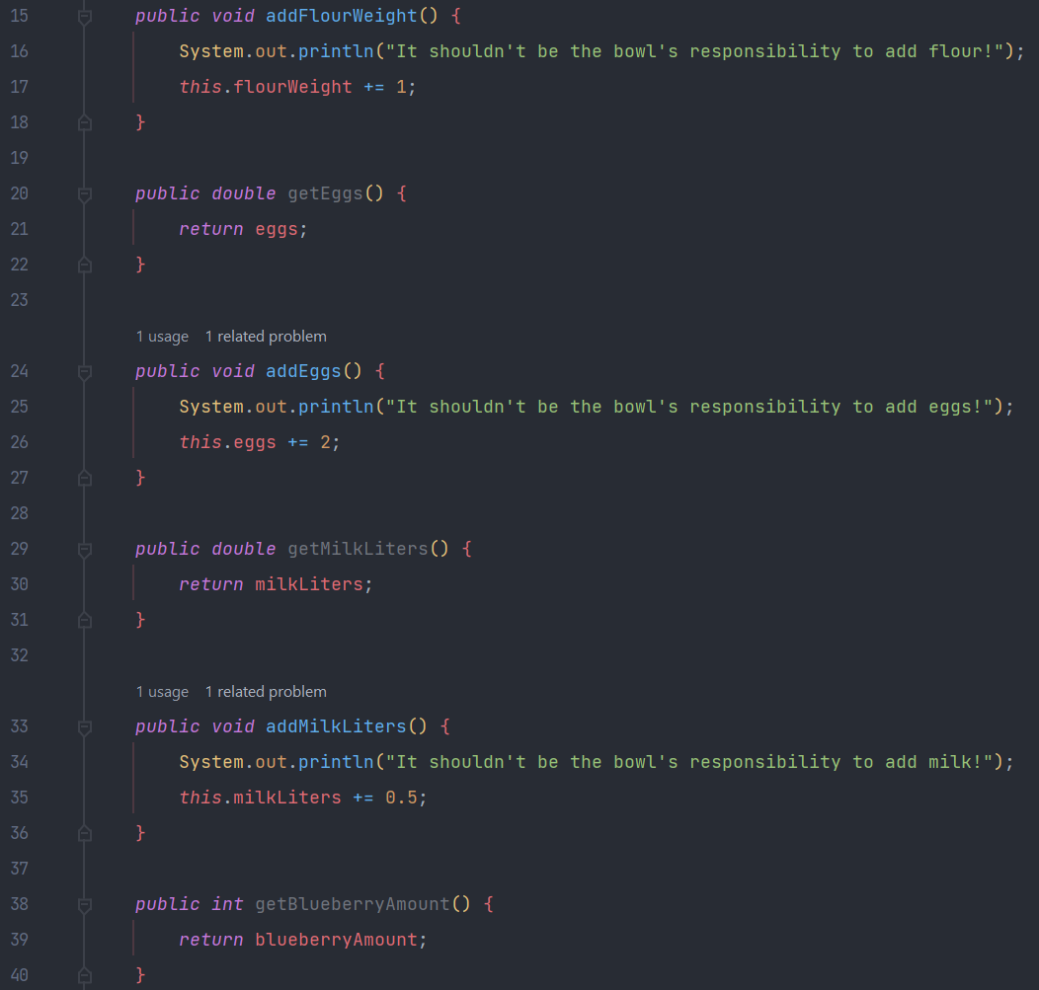

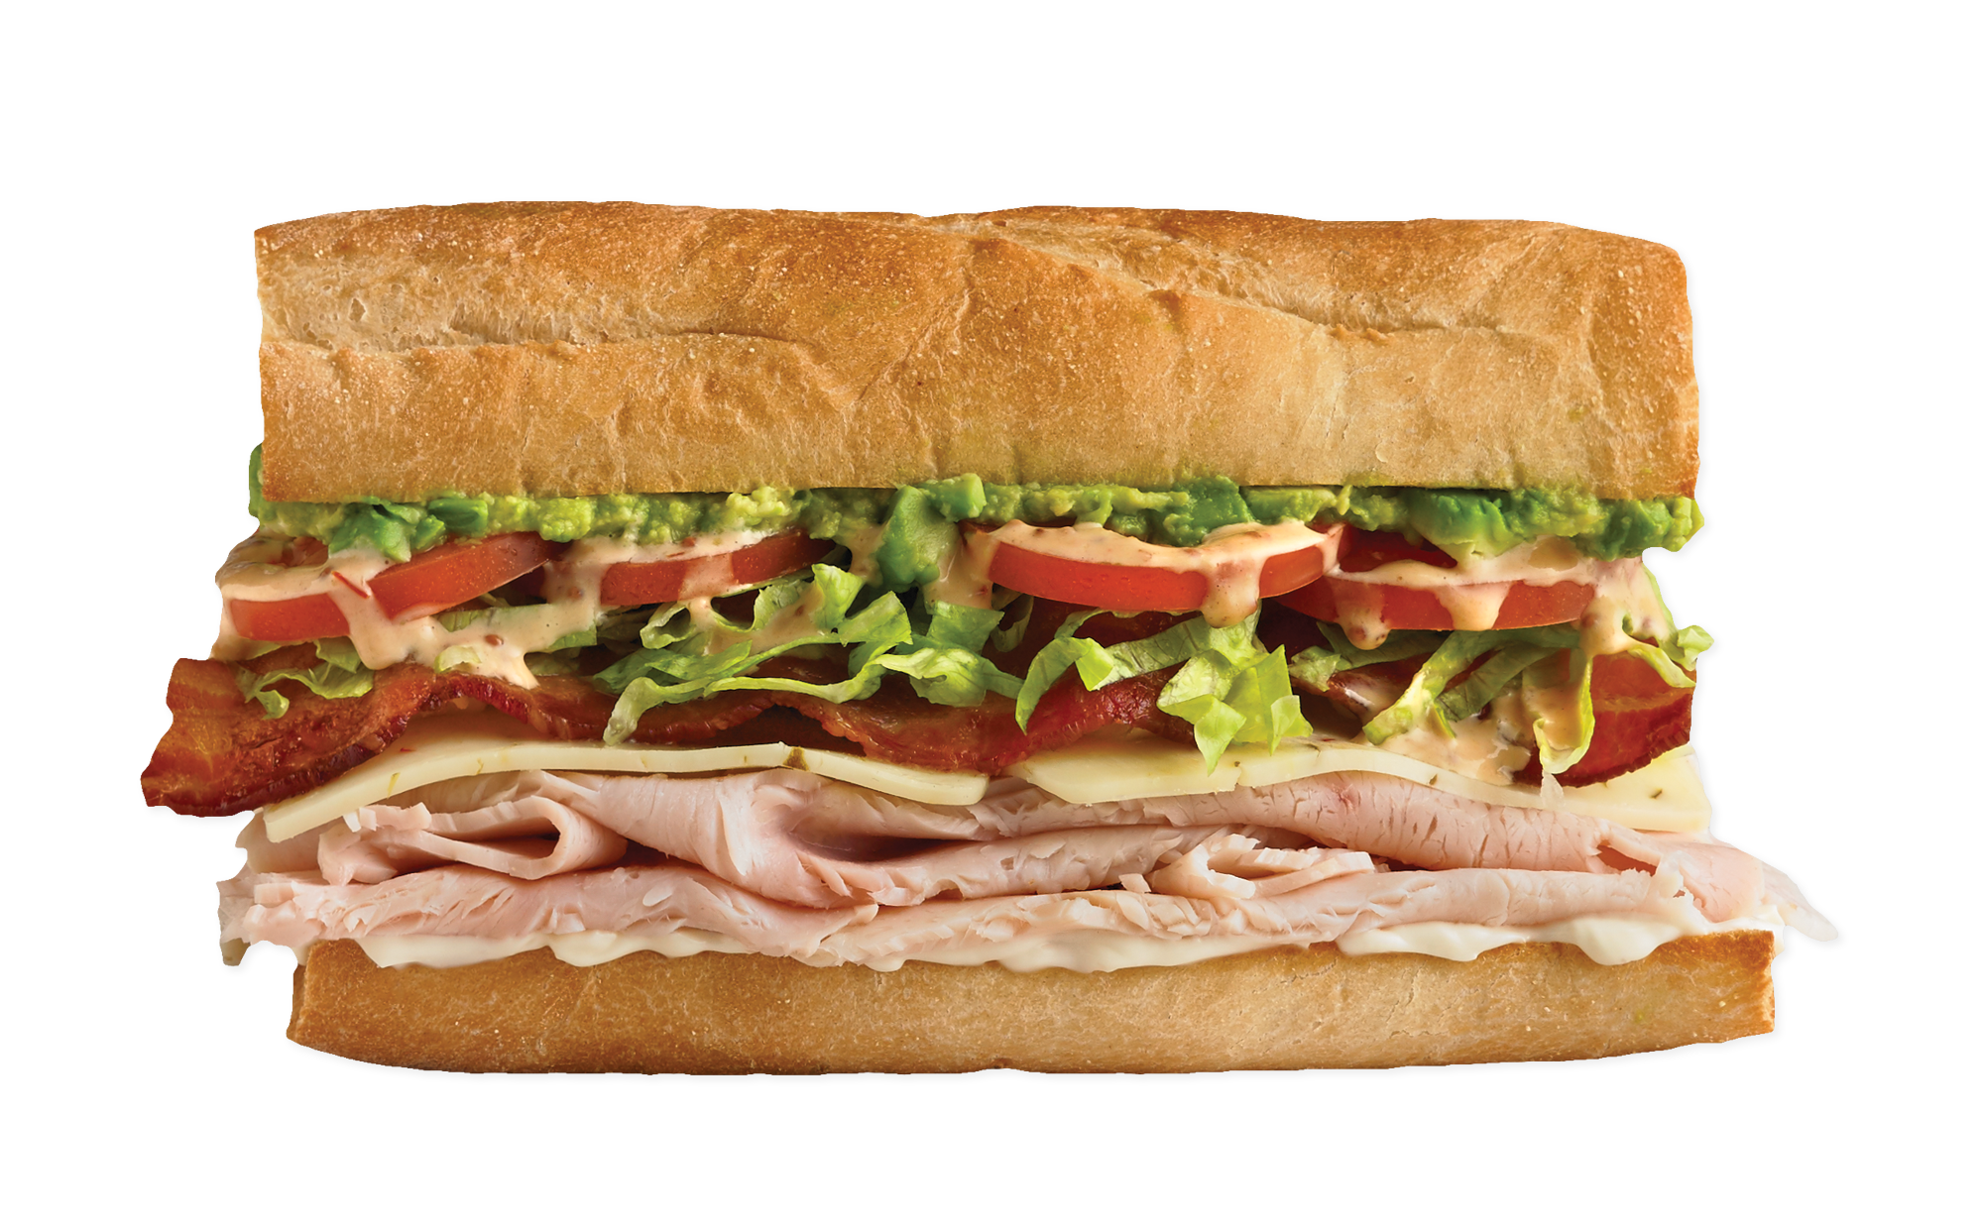
Object-oriented Programming (OOP)
Purpose: To separate concerns into entities (coded as objects)
Bad Code example: Real life cake into code (in Java)
Good Bowl class:
Bad Bowl class:
What if instead of Jordan making a cake, we want Gordon Ramsay to bake a cake? He’ll surely do things differently. But right now he can’t because the bowl is the boss.

Slide 18
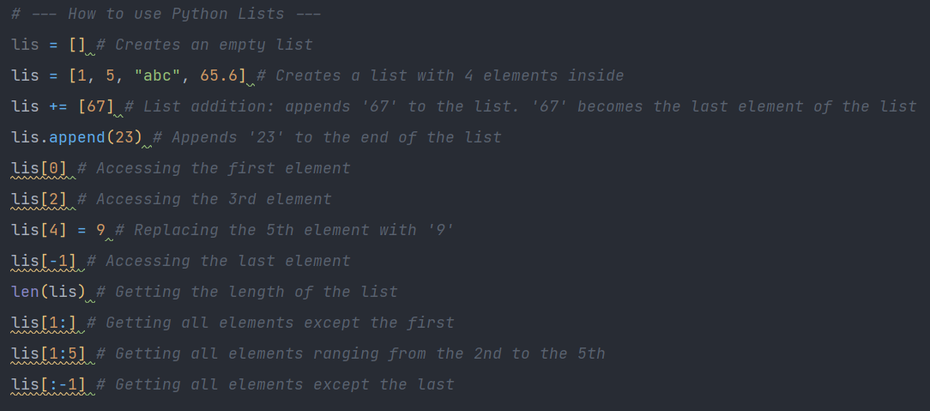
Object-oriented Programming (OOP)
Data Abstraction
Code example: Lists (in Python)
How do they work?
-Doesn’t matter.
What do they do?
-Store elements, access elements
How do I use them?
-Check their interface

Slide 19
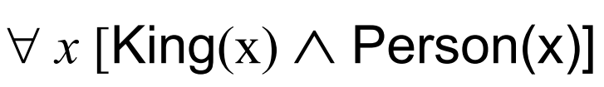



logic Programming
Logic clauses
Ex: First Order Logic
Facts and rules
Ex: First Order Logic
Facts: King(nexus) IsSoundFile(dotwav)
Rules:
Ex: Textual form
Facts: Socrates is a man
Rules: All men are mortal
By encoding these facts and rules in a logical program, the program would be able to infer the fact that Socrates is mortal (because he is a man)
Prolog (logical (and somewhat functional) programming language)
amy
alice
jennifer
Ex: parentOf(amy, alice). % This means that amy is the parent of alice
parentOf(alice, jennifer). % Facts are stated with a predicate followed by constants
grandparentOf(X, Y) :- parentOf(X, Z), parentOf(Z, Y). % X is the grandparent of Y if X is the parent of Z and Z is the parent of Y
Is amy the grandparent of jennifer? Yes, because this
grandparentOf(amy, jennifer) :- parentOf(amy, alice), parentOf(alice, jennifer).
can be inferred from the facts and rules previously established
Notes:
Programming languages that employ the Logic Paradigm allow programmers to write logic clauses, often written as Facts and Rules. Without explicitly saying that amy is the grandparent of jennifer, Prolog can infer this fact if we query it.

Slide 20
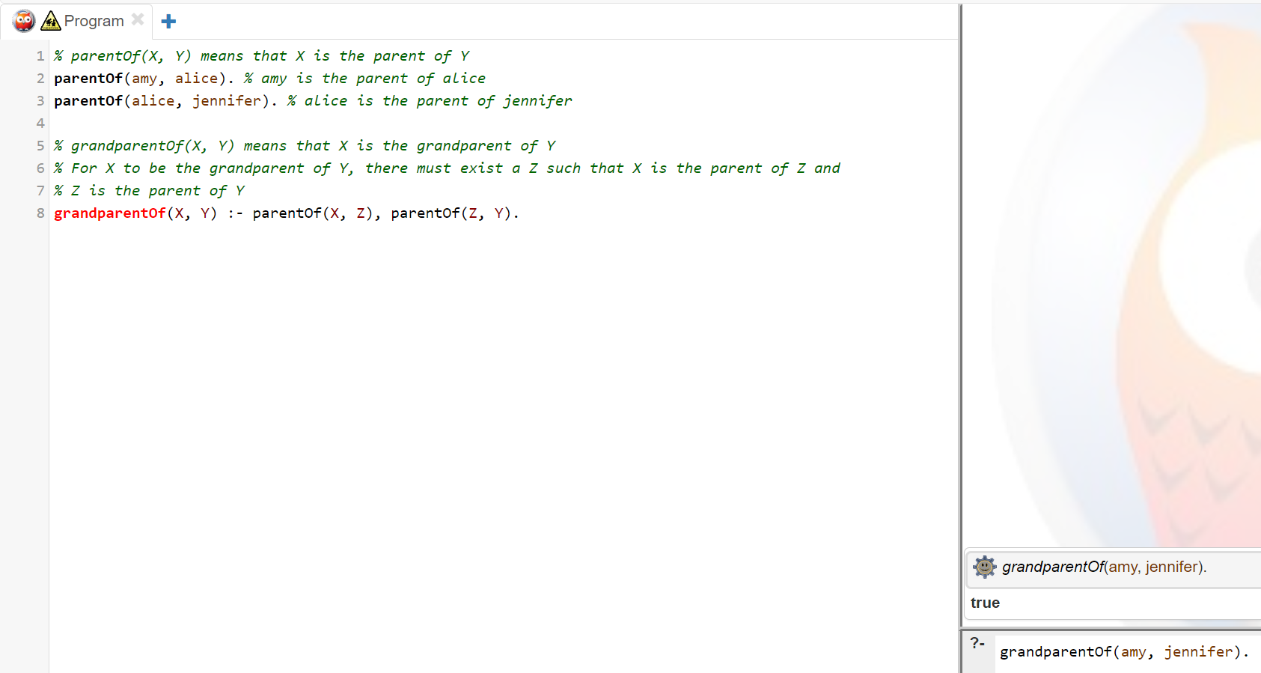
logic Programming
https://swish.swi-prolog.org/
Syntax:
UpperCamelCase:
Variable names
lowerCamelCase:
constants
predicates
records
predicate
constant
predicate
variable
variable
Facts and rules
Queries

Slide 21


logic Programming
Real life example: Figure out who can watch what movies
Facts:
Robert is 16.
Amy is 18.
The minimum age required to watch scary movies is 15.
The minimum age required to watch sexual movies is 18.
Rules:
A person can watch a movie if their age is equal or greater than the movie’s minimum required age.
Code example: (Prolog)
?- canWatch(amy, sexual).
true.
?- canWatch(robert, sexual).
false.
?- canWatch(X, scary).
X = robert;
X = alice.
% Facts:
age(robert, 16). %age of robert is 16
age(amy, 18).
minimumAge(scary, 15).
minimumAge(sexual, 18).
% Rules:
% canWatch(X, Y) means that X can watch movie Y
canWatch(X, Y) :- minimumAge(Y, MinAge), age(X, Age), Age >= MinAge.

Slide 22
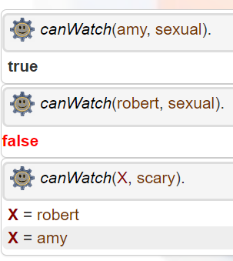

logic Programming

Slide 23
logic Programming
Topic9_Prolog/src/Exercises
Exercise 1 and 2.
https://swish.swi-prolog.org/

Slide 24

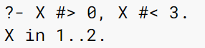
logic Programming
Constraint Programming (with a Prolog extension)
Applications: planning, scheduling, resource allocation, computer graphics, digital circuit design, fault diagnosis
Notes:
Variables are no longer bound by values. They are bound by restrictions.

Slide 25

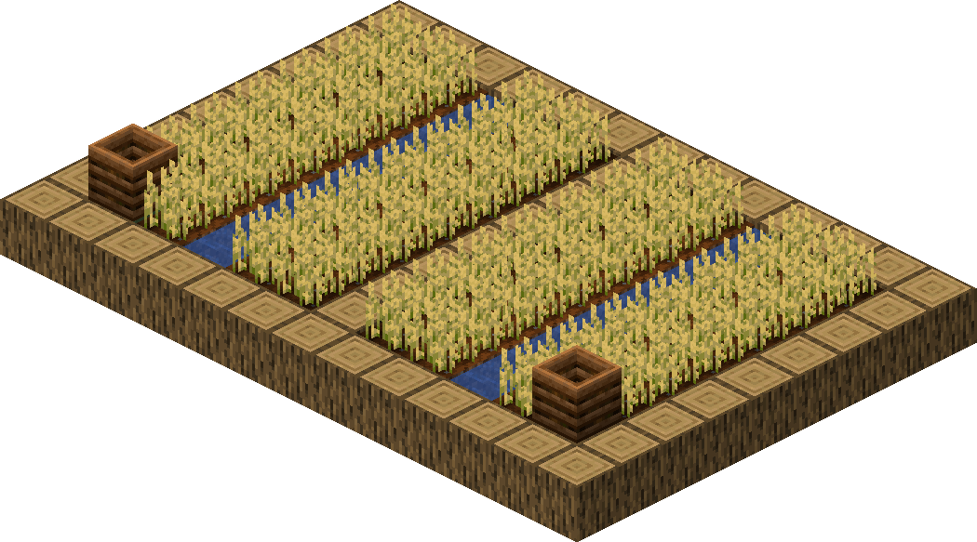

logic Programming
Constraint Programming (with a Prolog extension)
Code example: Fertilizers and fences for fields (Real life and Prolog)
1) How many Kilograms of fertilizer do I need to guarantee that each square meter gets at least 1 Kg?
I don’t want to spend too much money. I don’t want the land to receive too little fertilizer.
2) How many meters of fence do I need to fence off the entire field? I don’t want to spend too much money.
I don’t want to have holes in the fence perimeter.
Between 48m and 53m
Between 90m and 110m
Notes:
Lets say you are a farmer who wants figure out much fertilizer and meters of fence you. Your measurements of length and width are imprecise because you’re measuring with your feet

Slide 26
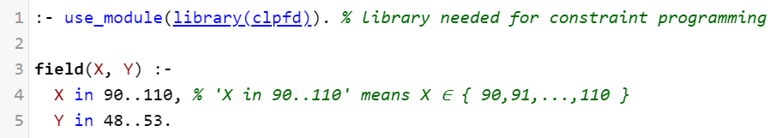
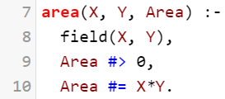
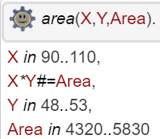
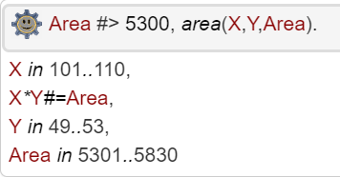
logic Programming
Constraint Programming (with a Prolog extension)
Code example: Fertilizers and fences for fields (Real life and Prolog)
1) How many Kilograms of fertilizer do I need to guarantee that each square meter gets at least 1 Kg?
I don’t want to spend too much money. I don’t want the land to receive too little fertilizer.
In other words, we want to know the area of the field
Notes:
Lets say you are a farmer who wants figure out much fertilizer and meters of fence you. Your measurements of length and width are imprecise because you’re measuring with your feet

Slide 27
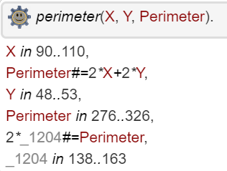
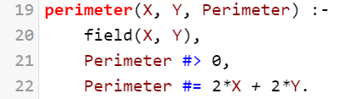
logic Programming
Constraint Programming (with a Prolog extension)
Code example: Fertilizers and fences for fields (Real life and Prolog)
2) How many meters of fence do I need to fence off the entire field? I don’t want to spend too much money.
I don’t want to have holes in the fence perimeter.
In other words, we want to know the perimeter of the field
Notes:
Lets say you are a farmer who wants figure out much fertilizer and meters of fence you. Your measurements of length and width are imprecise because you’re measuring with your feet

Slide 28
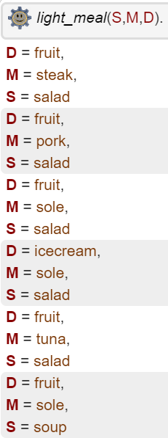
logic Programming
Constraint Programming (with a Prolog extension)
Code example: Planning our next meal (Prolog)
?- light_meal(S,M,D).
meat(steak,5).
meat(pork,7).
fish(sole,2).
fish(tuna,4).
dessert(fruit,2).
dessert(icecream,6).
main_course(M, I) :- meat(M, I).
main_course(M, I) :- fish(M, I).
starter(salad, 1).
starter(soup, 6).
light_meal(S,M,D) :-
I #> 0, J #> 0, K #> 0, I + J + K #=< 10,
starter(S, I), main_course(M, J), dessert(D, K).
I+J+K=0, I>0, J>0, K>0, starter(S,I), main_course(M,J), dessert(D,K).
S=salad, I=1, 1+J+K=0, J>0,K>0, 1>0, J>0, K>0 main_course(M,J), dessert(D,K).
.
.
.
S=salad, I=1, M=steak, J=5, D=fruit, K=2, 1+5+2=0, 1>0, 5>0, 2>0.

Slide 29
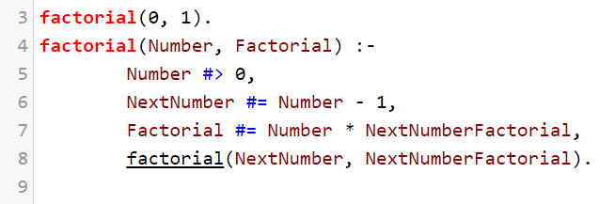
logic Programming
Topic9_Prolog/src/Exercises
Exercise 3.
https://swish.swi-prolog.org/
?

Slide 30

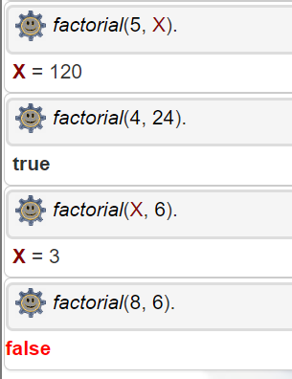
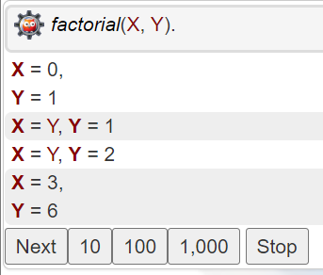
logic Programming
Predicate arguments
Can be both input and output arguments
in
out
out
out
in
in
out
in
I could go on asking for more factorials
in
in

Slide 31

logic Programming
Advantages:
Memory efficient
Can infer knowledge
Proximity with natural language
Inferring knowledge is built-in
Used in AI Knowledge-based systems
Easier to program puzzle solvers
Disadvantages:
Inferring can be very slow
Can get messy quickly
Very different from what we’re used to
Inferring may get stuck in an infinite depth search
No guarantees it finishes inferring
Hard to integrate with other paradigms

Slide 32

Programming Paradigms
Imperative
Procedural
Functional
Object-oriented
Logic

Slide 33


Slide 34


High Order Programming

